Slide 1
Smart Plant Pot

Slide 2
PROJECT’S GOAL
The goal is to automatically manage an house plant; it allow to acquire, process and implement all the essential information for the survival of a plant in a domestic environment. In particular it will be possible to acquire values ​​about the temperature and humidity of the environment, the soil moisture, and the light projected towards the plant. Using these values the system decides if it’s necessary to power the water pump or the led lamp. Last but not least there is sensor to control if the water tank is empty.

Slide 3
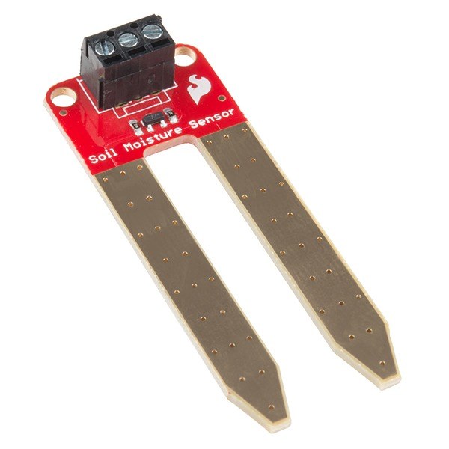
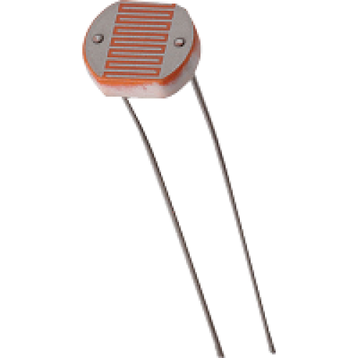
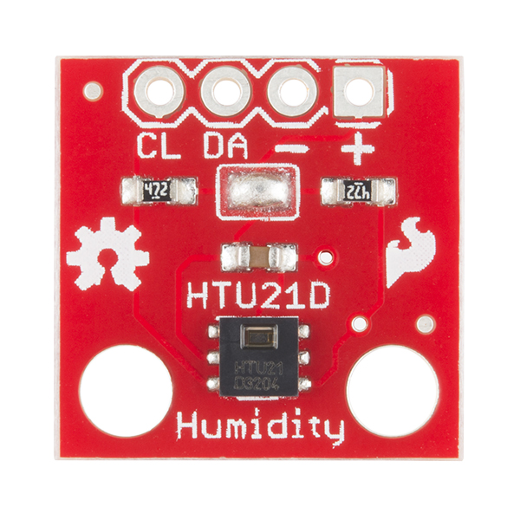
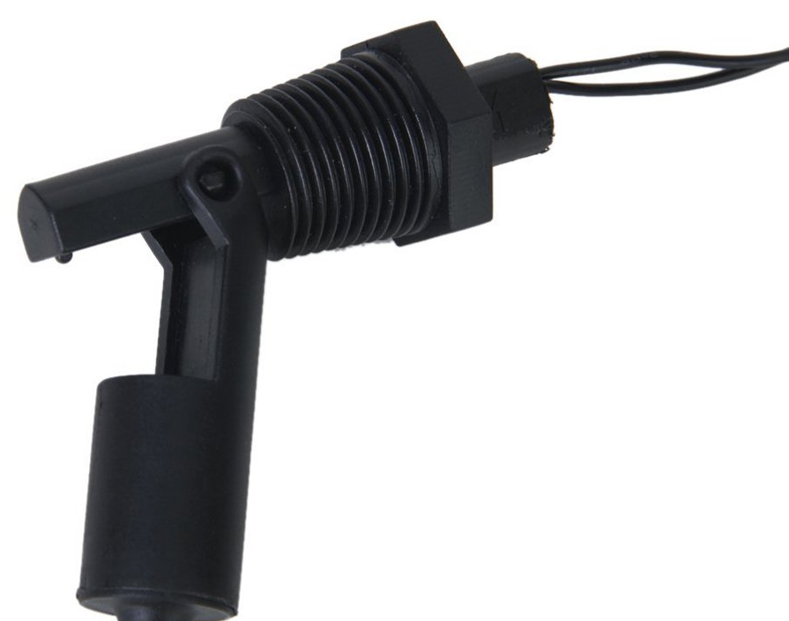
Sensors list:
Soil moisture sensor
Light sensor
Humidity and temperature sensor
Water level sensor

Slide 4
Other components
Light illumination system
Water pump
Relay

Slide 5
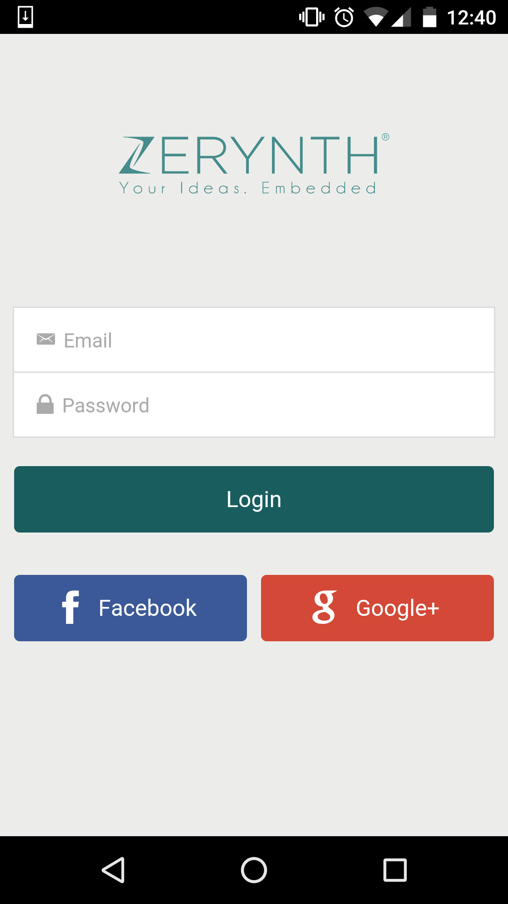
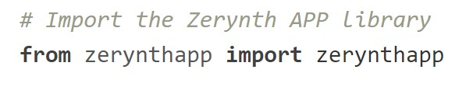
How the ESP32 comunicate with the app?
We built our app with the Zerynth app.
Zerynth allow programmers to use dedicated libraries to exchange data between the MCU and the app.

Slide 6
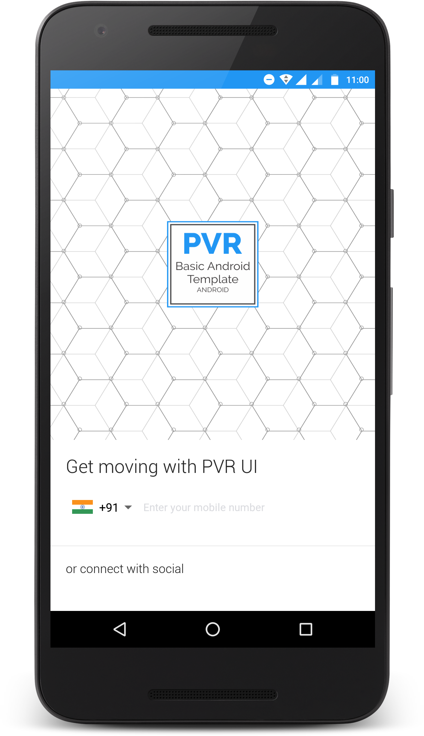
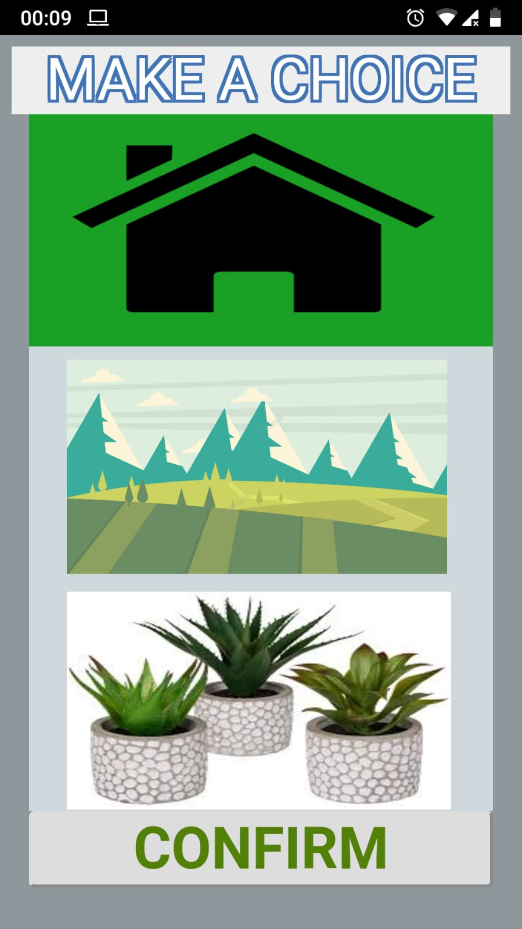
App features
The user can choose three presets for different kind of plants: Indoor, Outdoor and Succulent Plant.
Each preset was created based on tests performed on the different types of plants :)

Slide 7
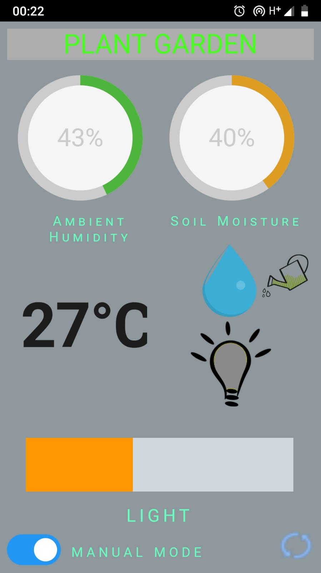
App features
The user can switch between two different modality: Manual and Automatic.
The app show the information acquired by sensors of the smart plant pot
In Manual mode the user can control directly the Irrigation System and the Light System

Slide 8
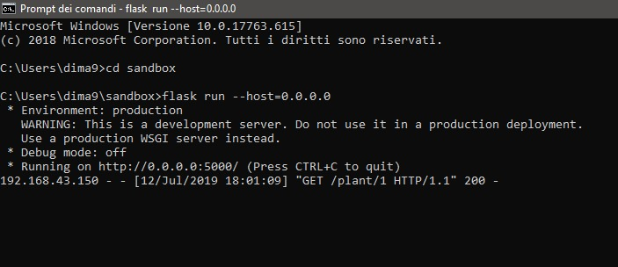
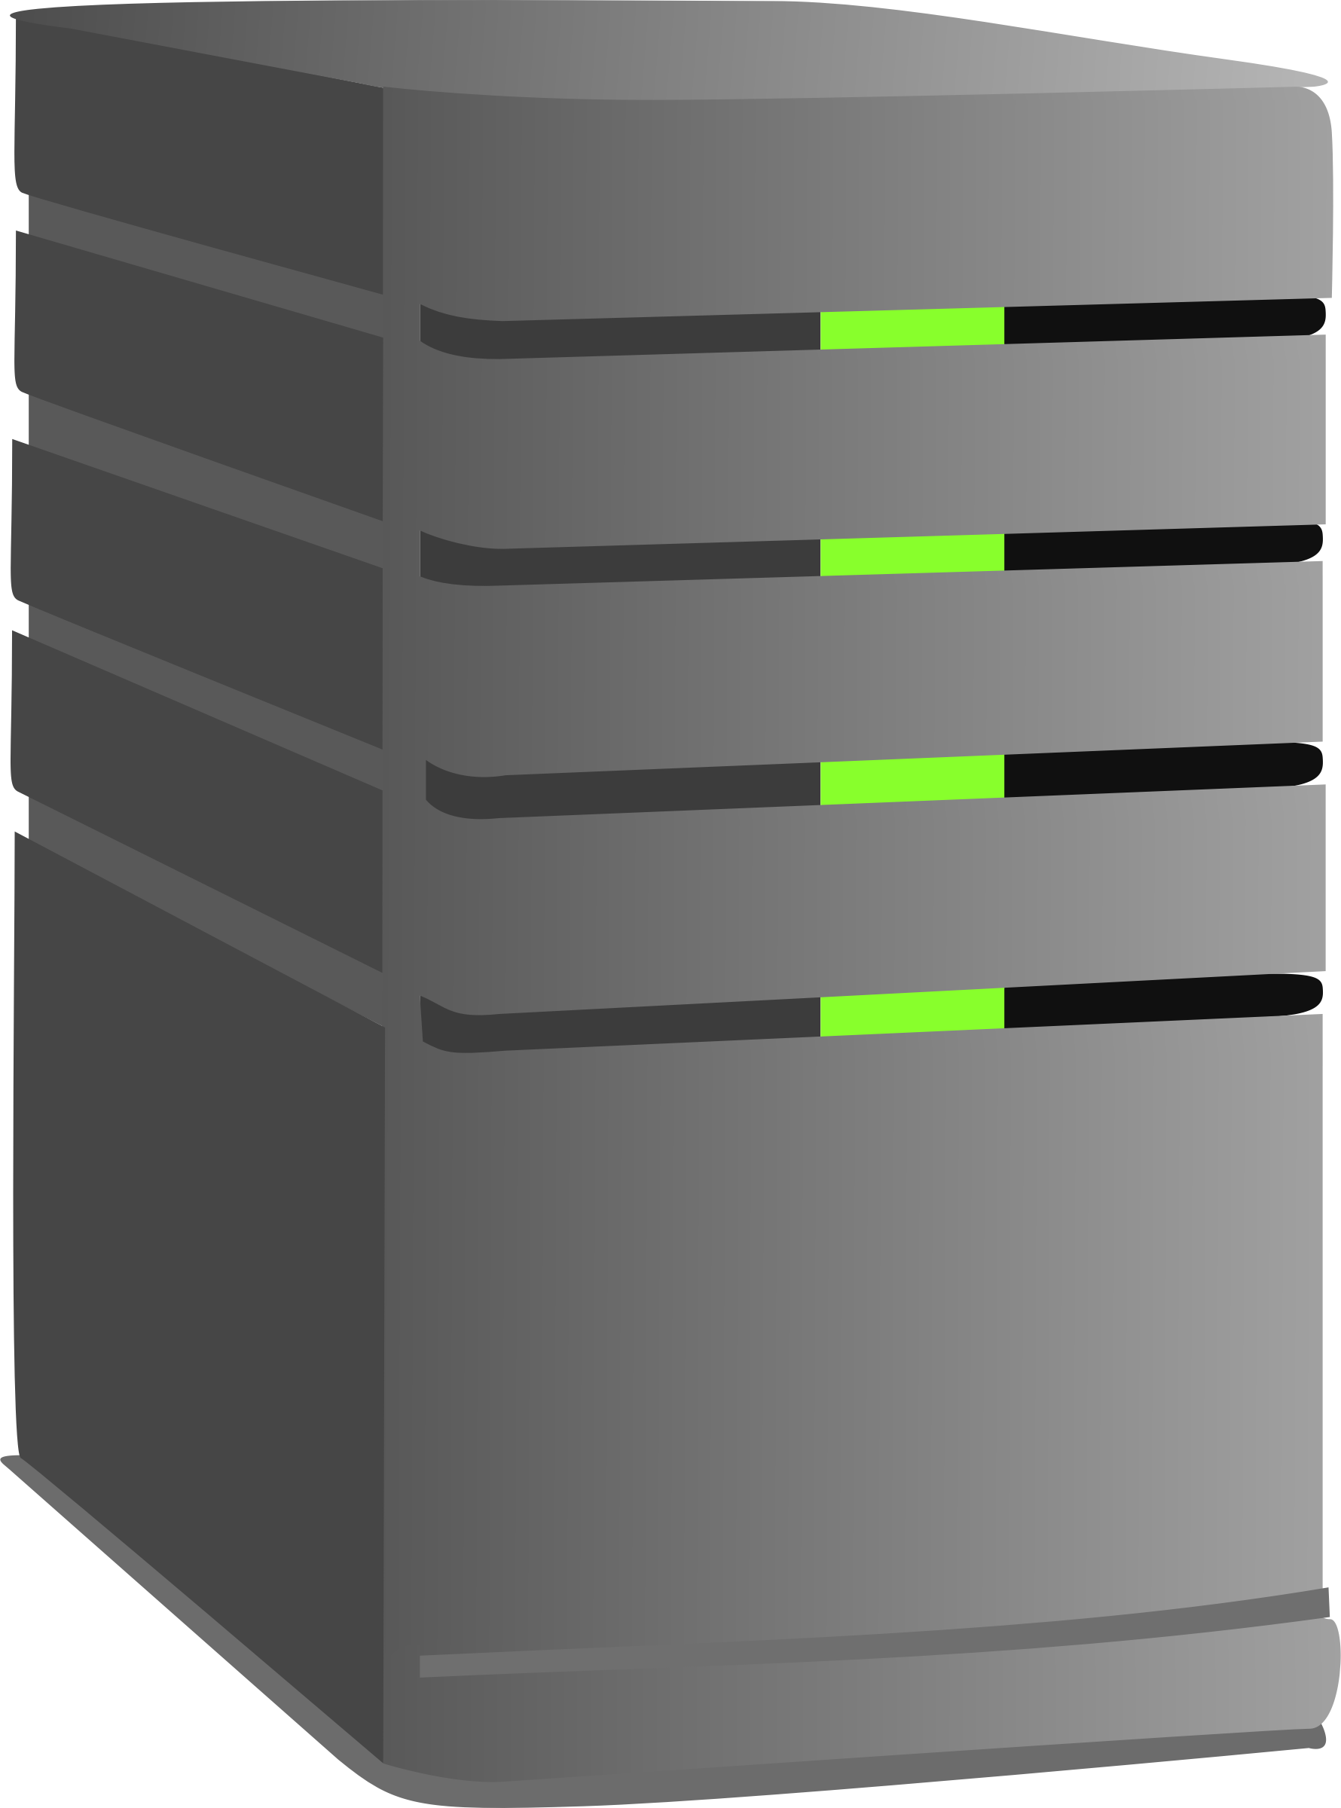


Based on the choice of the plant made by the user, the relative preset will be loaded from a server created using Flask, a python framework. The implementation of the server is designed using REST design pattern.

Slide 9
Manual vs Automatic Mode
In automatic mode the management of the plant is totally entrusted to the MCU
In manual mode the user can see with the app all the data acquired by the sensors but light and water pump can be turned on/off only if he communicates it through app

Slide 10
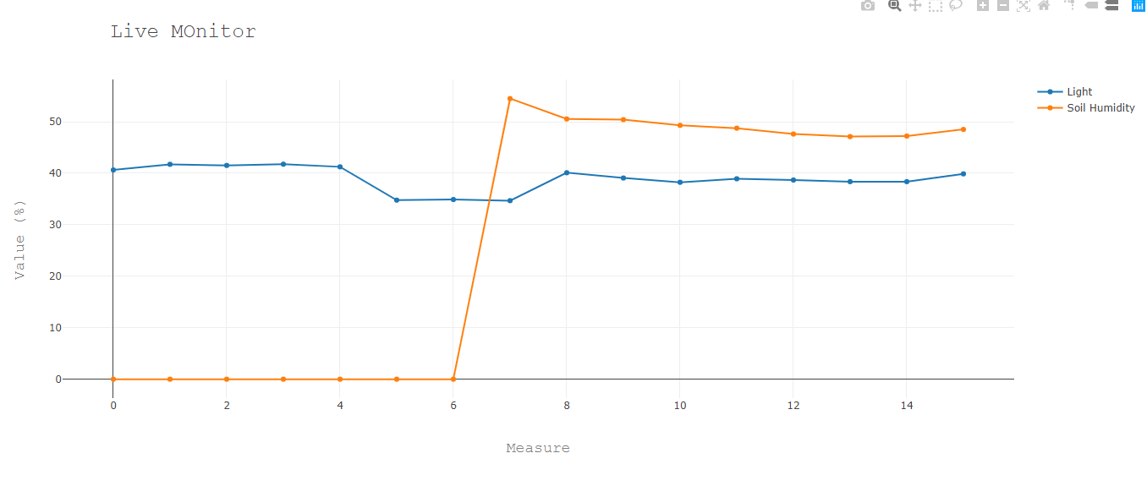

The Live Monitor
This graph shows an overview of the conditions of the environment in which the plant is located. Value of light and soil moisture is plotted. The protocol used to exchange data is MQTT.

